Slide 1
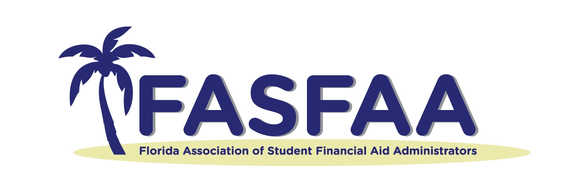

A Deep Dive
Into Student
Loan Repayment Assistance

Slide 2
Disclaimer
Members of the Association recognize that one of the purposes of the Association is to provide training and informational services to its members through training conferences and periodic written material. While the Association shall utilize its best efforts to provide its members with the most current information available, there can be no assurances or warranty that its interpretation of any rule, regulation or statue will be in conformance with any present or future interpretation of such rule, regulation or statute by any appropriate governmental authority. Accordingly, each member shall hold the Association harmless from any claims, damages, or liability resulting from such member’s use of any information, data, or interpretations as provided to such members by the Association.

Slide 3
About Ascendium
Established: In 1967 as a student loan guaranty agency, expanded
to include Federal Direct Loan Servicing for the Department of Education as Great Lakes; sold servicing to Nelnet in 2018.
Based: Madison, Wisconsin
Employees: 250+
Currently: A nonprofit that remains the nation’s largest student loan guarantor, a philanthropy whose mission is to elevate opportunities and outcomes for learners from low-income backgrounds, and provider of the Attigo® Suite of solutions which includes student loan repayment support.

Slide 4
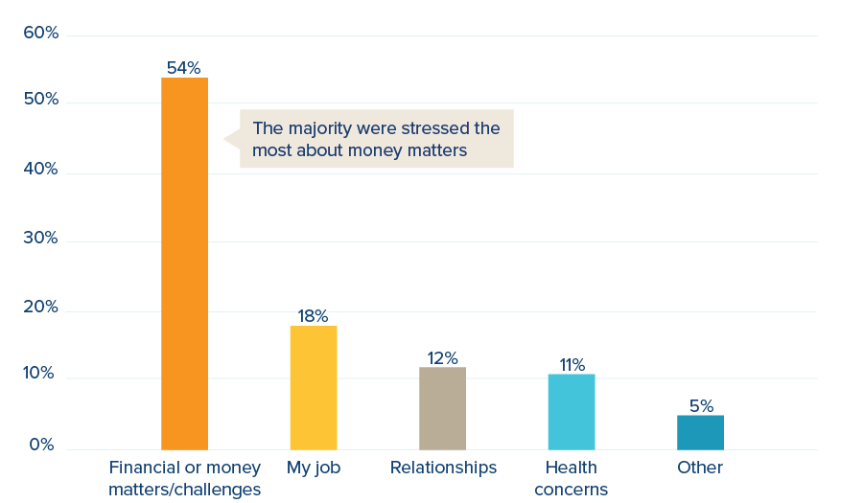
Financial Issues are a Top Concern
Which of the following causes you the most stress?
Source: Price Waterhouse Cooper
Notes:
pwc-9th-annual-employee-financial-wellness-survey-2020.pdf

Slide 5
Agenda
1
Student Loan Landscape
Student Loan Repayment Assistance (SLRA) Background
and Features
Critical Benefit for Borrowers and Businesses
Help your Alumni Take Action
2
3
4

Slide 6
Student Loan Landscape

Slide 7
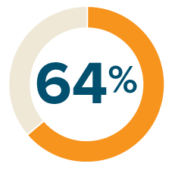

Burden of Debt Weighs Heavily on Borrowers
64
%
95
%
64% of adults feel a lot of stress or some stress about undergraduate student loan debt
of student loan borrowers
feel student loans are impacting their ability to meet their financial goals

Slide 8

Student Loans Impede Financial Goals
Key milestones delayed or prevented by student loan debt
62%
Building an emergency fund
51%
Saving for retirement
50%
Purchasing a home
46%
Paying off non-student
loan debt (e.g., credit card)
39%
Pursuing more education
34%
Purchasing or
leasing a car
Source: Ascendium SLRA Survey (2021)

Slide 9
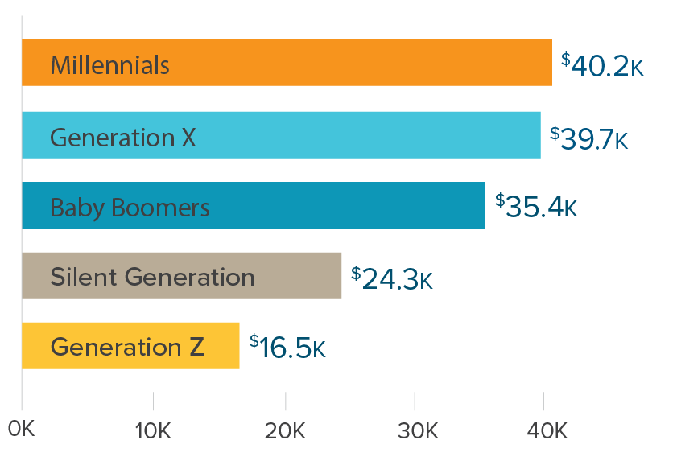
Not Just a Millennial Problem
44 million borrowers
$37,584 is the average amount of student loan debt per borrower
33% of federal student loan borrowers were struggling
to make their payments before COVID-19
Average Student Loan
Debt by Generation
Notes:
Sources:
https://studentdebtcrisis.org/student-debt-covid-survey/
Investopedia: https://www.investopedia.com/student-loan-debt-2019-statistics-and-outlook-4772007

Slide 10

Struggles Can Lead to Default
1 out of 5 people experience student loan default
and its lifelong consequences
  High collection fees
  Wage garnishment
  Credit score damage
  Withholdings from income tax
  refunds and Social Security
Notes:
Sources:
Brookings: https://www.brookings.edu/research/the-looming-student-loan-default-crisis-is-worse-than-we-thought/
PEW: https://www.pewtrusts.org/en/research-and-analysis/fact-sheets/2020/04/student-loan-default-has-serious-financial-consequences#:~:text=The%20U.S.%20Department%20of%20Education,go%20into%20default%20each%20year

Slide 11
SLRA Background and Features

Slide 12
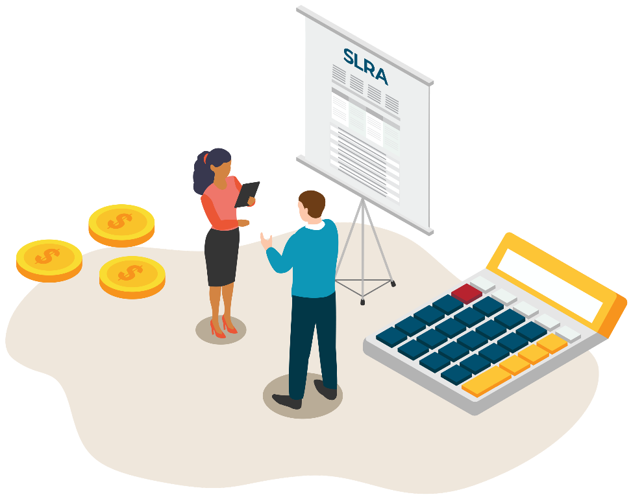
What is Student Loan Repayment Assistance?
Employers can make a tax-free contribution to their employee’s student loans by adding SLRA
to their benefit line-up

Slide 13
Key Features of SLRA
Employer Contribution:
  For employee’s student loans taken for their education
    Can pay employee like tuition reimbursement
    Can pay employee’s student loan lender or servicer
    Best when employer payment supplements
    an employee’s own payment
    Monthly, quarterly, annual payment

Slide 14

Coronavirus Aid, Relief, and Economic Security Act (CARES)
SLRA Employee Benefit:
  Started with the CARES Act which amended
  Section 127 of the Internal Revenue Code
    Only through December 31, 2020
    Legislation included a temporary
    provision permitting employers to amend
    Education Assistance Programs (EAPs) and
    pay up to $5,250 per year on a tax-free
    basis toward an employee’s student loans

Slide 15
Consolidated Appropriations Act
The Consolidated Appropriations Act, 2021 (CAA)
was signed into law on December 27, 2020
  One of its provisions was to extend the tax-free status
  of employer payments
  Must be included as part of Education Assistance Program
  Up to $5,250 per year
  Annual limit for all EAP
  Through December 31, 2025

Slide 16
Qualified Education Loans
Loans that qualify for SLRA participation
Both private and federal education loans obtained to pay for specific higher education expenses—including tuition, fees, room and board, books, supplies, and other necessary expenses—are covered

Slide 17
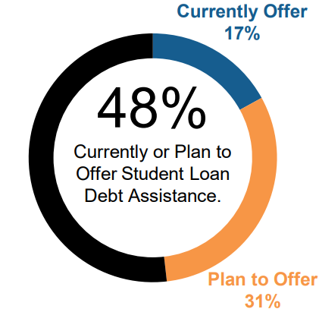
SLRA is a Growing Employee Benefit
“Financial wellness programs have evolved from a focus
on retirement preparedness to a more complete picture across all aspects of an individual’s finances.”
Employee Benefit Research Institute – October 2021
Notes:
https://www.ebri.org/docs/default-source/ebri-issue-brief/ebri_ib_544_fwes2021-28oct21.pdf?sfvrsn=51443b2f_4

Slide 18
Critical Benefit for Borrowers and Businesses

Slide 19
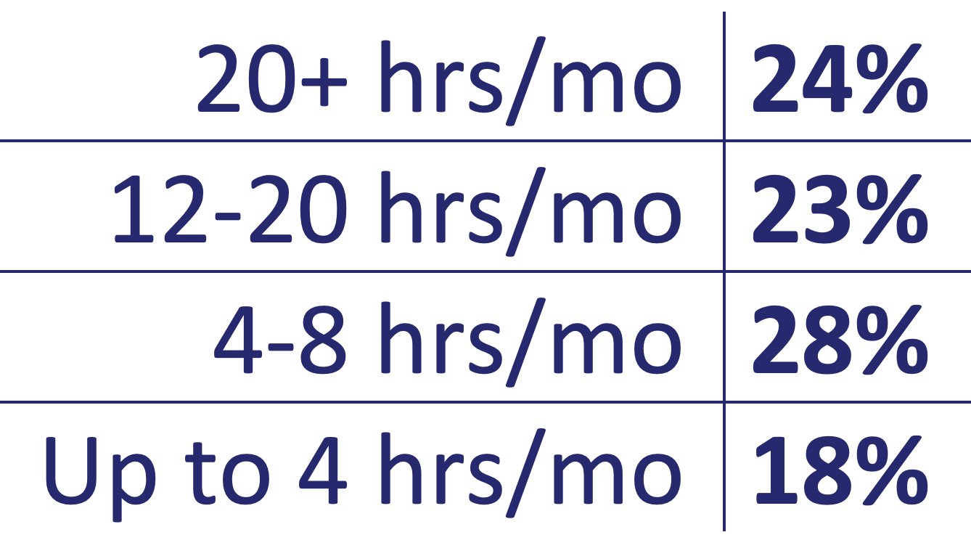
Employers Are Learning About Student Debt
Financial stress impacts work-life balance and performance
Financial stressors remain
a top concern for 45 million Americans with student debt
93%
said they deal with financial
stressors at work
58%
said personal financial issues impact
their work performance or productivity
Source: Ascendium SLRA Survey (2021)

Slide 20

Better Benefits Lead to Retention
72%
said their work performance or productivity
would increase if their employer contributed
to their student loan
Source: Ascendium SLRA Survey (2021)

Slide 21
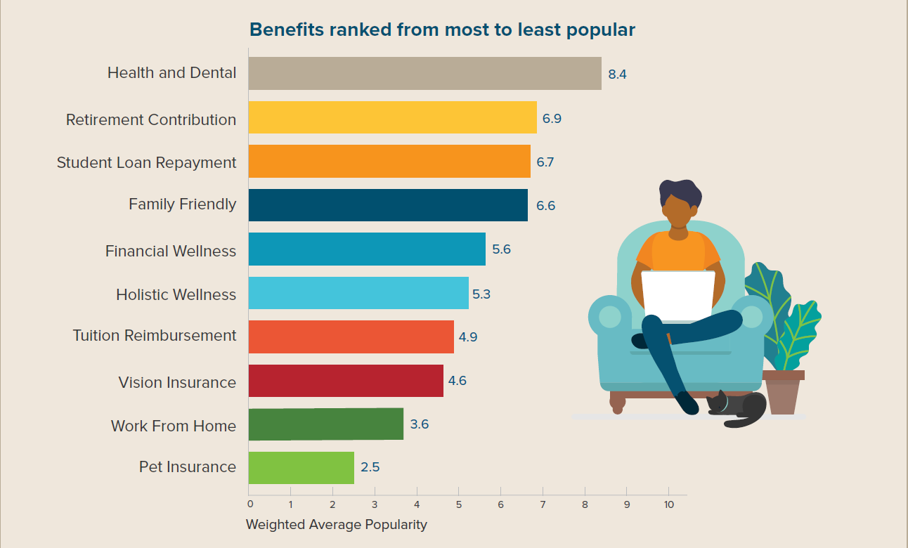
Employees Know Which Benefit They Want

Slide 22
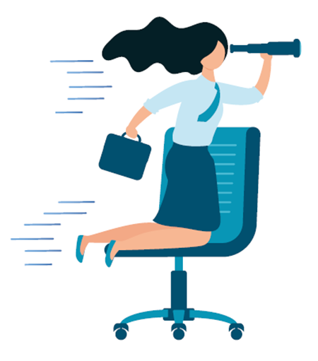
Why Employers Are Stepping Up
The Turnover Tsunami
  Baby boomers retiring
  in record numbers
  Employees put job opportunities on hold
  during the COVID-19 crisis
  People looking for a change, better pay and benefits
40%
will likely pursue
a new position
within the next year
Source: bls.gov and Ascendium SLRA Survey (2021)

Slide 23

SLRA Pays For Itself
Cost of Turnover
  Estimated cost of losing an employee
  is 1.5 – 2 times their salary
  Tangible Costs
    Recruitment
    Onboarding and Training
  Intangible Costs
    Poor Morale
    Lost Productivity
    Diminished Brand
Source: LinkedIn
Notes:
https://www.linkedin.com/pulse/what-true-cost-turnover-john-chisham/
https://jcenterprisesllc.mykajabi.com/blog/what-is-the-true-cost-of-turnover

Slide 24
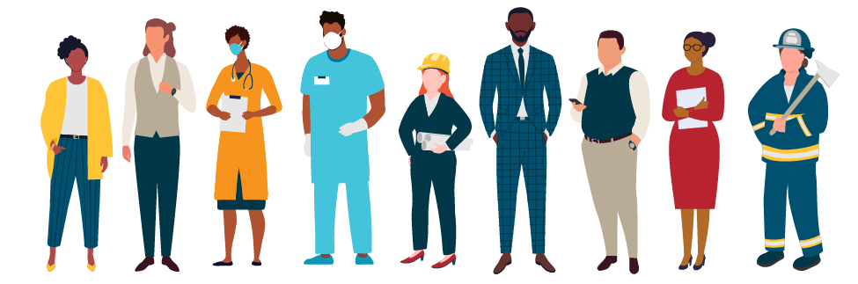

A Powerful Reason to Stay
88%
Would increase their commitment
to their employer if offered SLRA.
Source: Ascendium SLRA Survey (2021)

Slide 25
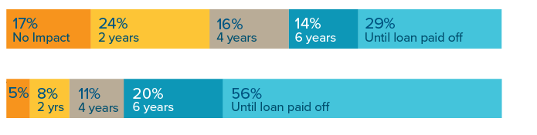
What Employers Need to Know
How SLRA contribution impacts commitment
83%
would increase commitment if received a $100
monthly contribution
95%
would increase commitment if received a $437.50 monthly contribution
$100 monthly
contribution
$437.50 monthly
contribution
Source: Ascendium SLRA Survey (2021)

Slide 26
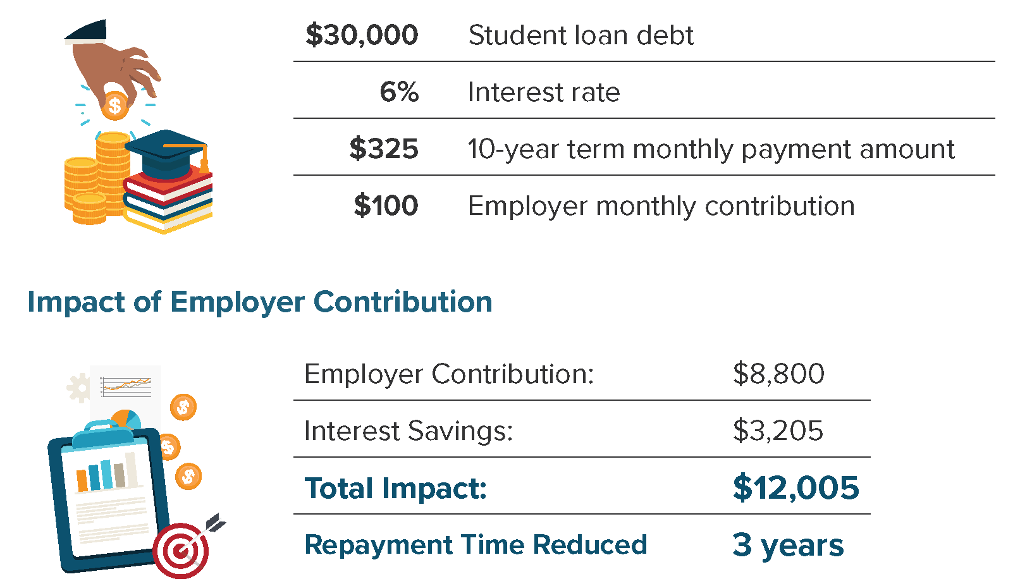
$100/Month Over 7 Years of Employment
SLRA brings benefit to employees and employers:

Slide 27
Help Your Alumni Take Action

Slide 28

Where to Begin
Provide students and alumni with resources
to learn about SLRA
  Exit Counseling
  Financial Wellness Program
  Alumni Campaign
Encourage them to ask employers about SLRA
Introduce SLRA to employers who visit campus

Slide 29

Next Steps
Advocate for SLRA
  Extend beyond 2025
  Lift the annual maximum
  Include Parent PLUS
Follow Legislation
  NASFAA.org/Advocacy
  H.R. 902 - Debt Act of 2021 – Would increase
  annual maximum to $10,000
  State-Based: PA SB400, NJ A2211, KY HB255

Slide 30
SLRA Resources to Assist You
Learn More at
www.attigo.com/resources
  SLRA Infographic
  How to Get Your Employer to Help
  Pay Down Your Student Loans
  Employers Guide to Student Loan Repayment Assistance
  Top 4 SLRA Program Facts
  Often Misunderstood

Slide 31

We Provide Co-Pay Partners
Student Loan
Repayment Assistance
Co-Pay Partners®️
Make contributions
to employee student loans
to help them conquer their
debt more quickly

Slide 32



Pair with Loan Counseling Support
Address Borrower Challenges
  Help determine best repayment option
  Loan servicer contact info, terminology
  Protection from scammers, fraudsters
Knowledgeable Team
  Mission-driven approach
  Clear, accurate guidance
  24/7 access to online Knowledge Center
  Toll-free number
Combine Products
for Maximum Impact
Student Loan Repayment Assistance
Co-Pay Partners®️
Student Loan Counseling
Student Loan Success CenterTM
Online Financial Education
Knowledge Center️

Slide 33
Thanks for Attending
Visit attigo.com

Slide 34























Business Partners

Slide 35
Questions?

