Slide 1
Graduate and professional debt management services Marissa Miles, MA,
Edith Vannesa Weiss, MS June 2, 2022
Notes:
Hello everyone and welcome to the presentation on Graduate Professional Debt Management Services

Slide 2
Disclaimer
Members of the Association recognize that one of the purposes of the Association is to provide training and informational services to its members through training conferences and periodic written material. While the Association shall utilize its best efforts to provide its members with the most current information available, there can be no assurances or warranty that its interpretation of any rule, regulation or statue will be in conformance with any present or future interpretation of such rule, regulation or statute by any appropriate governmental authority. Accordingly, each member shall hold the Association harmless from any claims, damages, or liability resulting from such member’s use of any information, data, or interpretations as provided to such members by the Association.

Slide 3
Agenda
Why it’s important?
Who benefits from this?
MoneyTALKS
CanvasMed course
FAAB
Zoom
Takeaways
Notes:
For our agenda today we will look at why the presentation is important, and who will benefit from it. We will take a look at FIU’s current MoneyTalks financial literacy program, and the financial assistance CanvasMed course webpage. Then we will talk about the Financial Aid Advisory Board and finalize with some Zoom tips and takeaways from today.

Slide 4
Poll #1
Does your school have an existing financial literacy program for medical/graduate students?
https://PollEv.com/vanneweiss541
Notes:
First, I wanted to conduct a quick poll to ask: Does your school have an existing financial literacy program for medical students? It’s a simple yes or no answer. I will give a minute for everyone to respond

Slide 5
Word Cloud
If your school has an existing financial literacy program, what is one issue you’ve encountered?
-e.x.: Programming, student engagement, presenter availability, funding, etc.
https://PollEv.com/vanneweiss541
Notes:
Wonderful results from the Poll, now for those who do have that kind of program. If your school has an existing financial literacy program, what is one issue you’ve encountered? I have attached the link to the word cloud to the chat and you can also text to join the word cloud. ------- (after word cloud): We can see a few of the deficiencies of the programs at other institutions and I may have some advise for some of these issues in my slides.

Slide 6
Why it’s important to have a financial literacy program?
Medical students may come from all walks of life. They may not always come from wealthy backgrounds. It is important that they learn how to manage their future wealth and have it work for them and their lifestyle!
Since medical school students graduate with a considerable debt ($215,900 in average*)
It helps guide potential doctors to learn about a vital part of financial planning **
Understanding their financial situation provides them a chance to plan for current needs and future needs and ways to pay them **
*Hanson M, Checked F. Average medical school debt [2022]: Student loan statistics. Education Data Initiative. https://educationdata.org/average-medical-school-debt. Published December 9, 2021. Accessed February 8, 2022.
**Turner T. Personal finance defined: What is personal finance? Personal Finance. https://www.annuity.org/personal-finance/. Published January 6, 2022. Accessed February 8, 2022.
Notes:
So, why is it important to have a financial supplemental program? Well, medical students may come from humble beginnings or may not have been taught growing up how to handle their finances or how to properly budget their money. It is very common to see. And with the average medical student graduating with over $200,000 in debt, they need to receive guidance for financial planning. When they understand their economic situation and are taught how to plan for it, they have the resources necessary to keep growing their funds and paying off their debt.

Slide 7
Who does this presentation benefit?
Notes:
Who may benefit from this presentation? Financial Aid offices, registrar, admissions, student programming, pre-health advisors. Or any department that deals with student programming, will have something useful to takeaway from this topic.

Slide 8
Debt Management Program Curriculum Required Schedule
Period 1 | Date
Fall Semester: Office of Financial Aid Orientation Presentation | August, Orientation, 1 hour
Entrance Counseling Session, One-on-One Appointment | Due by November, 1 hour
Spring Semester: Office of Financial Aid Debt Management Program Presentation | March, 1 hour
Period 2 | Date
Spring Semester: Office of Financial Aid Debt Management Program Presentation | March, 1 hour
Period 3 | Date
Spring Semester: Office of Financial Aid Debt Management Program Presentation | March, 1 hour
Period 4 | Date
Spring Semester: Office of Financial Assistance Exit Counseling Session Class Presentation | April, 4 hours
Exit Counseling Session, One-on-One Appointment | Due by April, 1 hour
Notes:
A little background to FIU’s existing financial program. As an accredited Medical School, we are required by the LCME to provide a Debt Management Program for our students. This is what it will look like for the next 4 years. We created both optional tasks as well as required. The optional task is to update the AAMC MedLoans Organizer and Calculator due in the Fall semester. We used to make them all required, but after hearing our student’s feedback, they honestly did not receive much for themselves with the Fall assignments, and some were even getting more anxious about their debt. So we left the assignment as an option for those students wanting to keep their information updated in the AAMC repayment calculator. We make sure to meet with our students at the beginning of their medical school career and offer advice in an entrance counseling that is mandatory for them, and we review their aid and their budgets. We present to them every Spring semester letting them know what to expect from their upcoming year from Financial Aid.
Lastly, we have an exit counseling that is required for them in their 4th years. Even though it is required, we have no way of holding the students responsible for it on their graduating year, but due to the content of the exits, the students usually are very pleased to attend. Additionally, during capstone we advertise it and we receive a huge influx of students getting ready graduate. Students also talk to each other after the meetings and do word of mouth advertising for us.
Any questions on our Debt Management Program before moving on?

Slide 9
MONEY
TALKS
*Zoom Platform Oriented
Notes:
The MoneyTalk financial literacy series was created to supplement the tools already provided through the Debt Management Program. Speakers from various specialties are invited to present to our students about topics related to debt and money management, building healthy credit, investing, home-buying, retirement, and more.

Slide 10
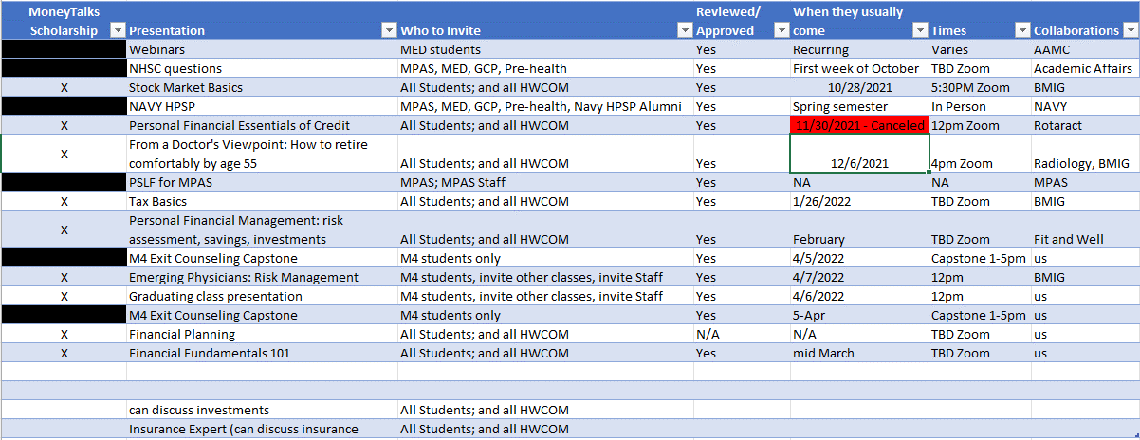
MoneyTalks Sessions breakdown
Notes:
All HWCOM students, faculty, and staff are welcome to attend (and in occasion some groups outside our college of medicine) and explore a variety of financial topics that will equip them to make sound financial decisions while in medical school and after graduation. We advertise to students through flyers and emails for these upcoming events. The series provides multiple webinars and guest speakers discussing an array of topics suggested and requested by our students.
Some of the features of the MoneyTALKS are:
Loan Repayment Seminars
Loan Forgiveness Seminars
Financial Literacy Information Sessions
We even included FIRST Friday Webinar Series Sessions that we feel may further benefit our students
In our office, we created this table with all the different presentations we have available for our students as well as the presenters we’ll be collaborating with, and so on. We try to schedule at least one event per month during Fall/Spring. Depending on the theme of the presentation, we can determine if we can bring in more student attendees or just our MDs. For example, the emerging physicians is mostly dedicated to M4s who will be graduating, as they can benefit the most from this presentation. But for Tax Basics, we invite the entire university as this subject can benefit any student or employee at FIU. We also have at the bottom a few suggestions that allow for swapping in case a presenter is not available.

Slide 11
MoneyTalk Series Policy
MoneyTalks Scholarship Opportunity
As part of the 2021-2022 academic year’s efforts to increase student engagement and participation in the MoneyTalks program, we have a scholarship opportunity available for those who attend the sessions.
We will be offering 1 award for a $500 scholarship to a student who attends at least 3 MoneyTALKS and meets the criteria
The HWCOM Office of Financial Assistance (OFA) is here to provide students with the resources they need to achieve their educational aspirations while successfully managing their finances.
Notes:
As an additional incentive for students to attend our MoneyTALKS, we created a $500 scholarship opportunity, we ensure that the students attend at least 3 sessions in order to qualify to receive it. Since all sessions are through Zoom, it is very easy to get a student count each time by pulling the list of attendees and updating our attendance records. Due to COVID and other schedule restrictions, we do allow for the students to make up any missed session by watching the video on the canvasmed page, and then answering a few questions. That way each session they watch on their own time will also count.
Students are then selected from the pool of eligible participants at random. We keep track of the student’s attendance and all those who attend or complete at least 3 MoneyTalks sessions are entered into the pool. Then with an online random generator 1 student is selected in April for a Spring award. We chose April to have time to incorporate all of our presentations for the year, while also including our M4 students for the running of the award.

Slide 12
MoneyTALKS: Collaborating with Interest Groups!
Encourages student-to-student advertising
The interest groups can hold their meeting as part of your presentation.
The IG may help by purchasing lunch for the attending students during the presentation. Free lunch brings in people!
Interest group leaders can also assist with scheduling events that will not share their timeslot with other events or academic deadlines.
Notes:
Another way our office has managed to increase student interaction with our MoneyTalks program is by collaborating with the many interest groups at FIU HWCOM. We try to have an interest group collaborating with us in every one of our events. They help advertise the event through the student’s social media accounts, they tell other students, and invite everyone from their interest group. This also helps the interest group presidents in creating content for their interest group (and we of course make sure to match the presenter and topic with the Interest Group to ensure they’re benefitting from it as well). The interest groups have also brought in presenters (people they may have heard from outside of school or they know personally). Additionally, the interest groups have funding for events that can be used to provide free lunch for in person presentation attendees. And believe me, free food brings in the people! Additionally, since you’re collaborating with students directly, they can tell you when to hold the event that will have the least opposition from other activities (such as class, exams, clinicals, etc). And when you find the perfect date to schedule your event and it doesn’t compete with any academic activity for students, those with availability will be more likely to attend.

Slide 13
MoneyTALKS Surveys
We created the surveys to make sure that the existing programs and events offered by our office were being well received by the attendees.
We make sure to also include an open-ended section to ask the attendees what they would like to see in future presentations. Thanks to this, we have managed to bring in presenters for very successful topics that are well attended!
Notes:
Lastly for our moneytalks, we send an after-event survey making sure that the presenters and content were well received, and it ends in one open ended question asking the participants what kind of topics they would like to see in the future! We have managed to create a ton of new content thanks to the surveys and have been able to deliver on the topics the students want to see and hear about.
Does anyone have questions about MoneyTALKS before moving on?

Slide 14
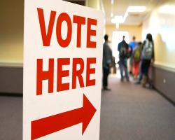
Poll #2
Does your school have an existing financial assistance web course?
https://PollEv.com/vanneweiss541
Notes:
We’ll pause to have our second poll.
Does your school have an existing financial assistance web course? – another simple yes or no question. I will give a minute for everyone to respond -------- Wonderful results from the Poll, we can see from the polls that there are/not many schools that have this option for their students.

Slide 15
CanvasMed Course
Notes:
We wanted our students to have a place where they could access everything they could possibly ever need from our office. So we created this financial assistance course web page so they could have all the info they need from us in an accessible manner. Our home page has a quick synopsis of our office, as well as image cards for our employees so the students get used to seeing who we are and our contact info in case they ever need us.

Slide 16
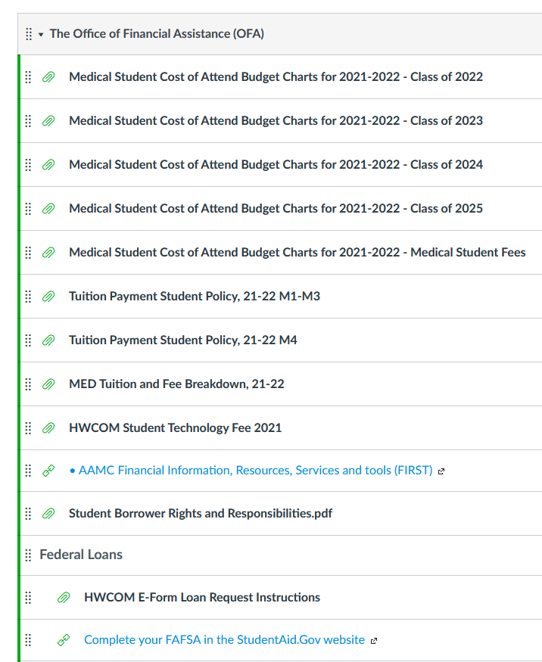
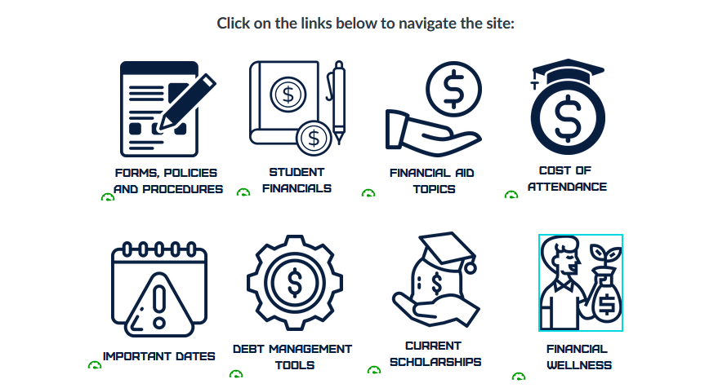
CanvasMed Links
Notes:
In the same home page, we created a few thumbnail links to direct students to different sections of the webpage course. For the Forms, Policy, and procedures link we compiled all the pertinent information, cost of attendance charts, guides, and tuition breakdowns in this area and share with our students in an effort to remain transparent and give access to all our tools to the students.
We used to get tons of emails about the yearly budgets too, so this helped reduce the email inquiries for this we normally received.

Slide 17
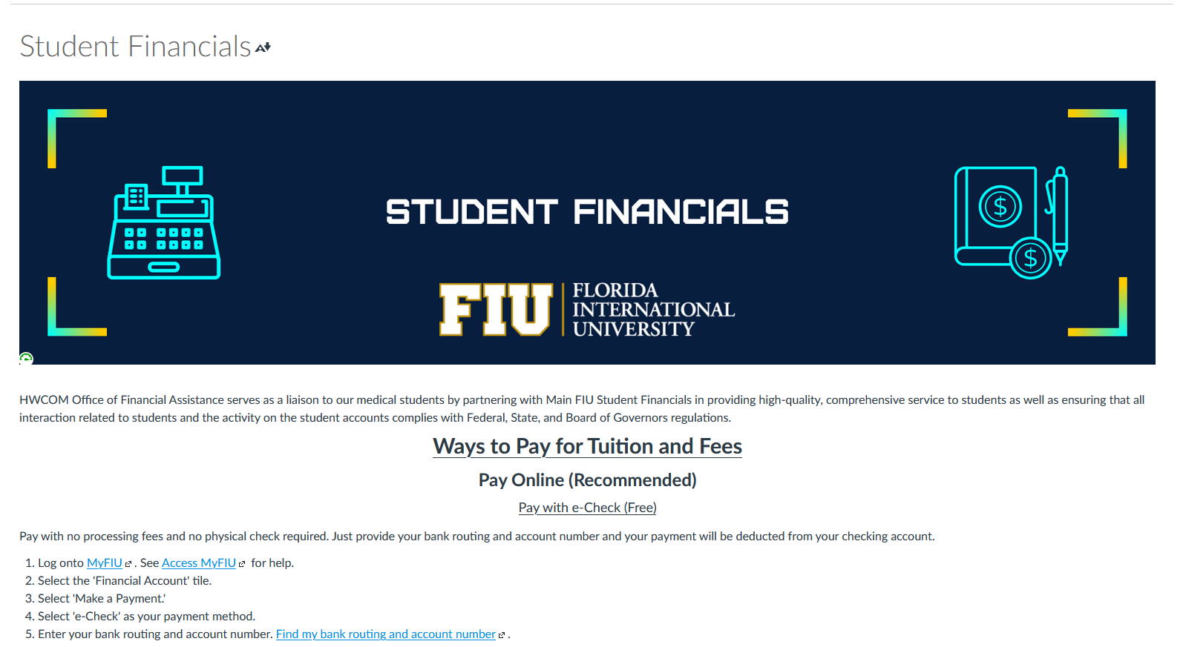
CanvasMed Links
Notes:
Next is the Student Financials page. Since this course is for financial aid recipients, and cash payers, we made sure to include instructions on paying tuition and the different acceptable payment methods to include the cash paying population of students. In the past, we would always lose a few points from the GQ due to the cash payers that did not have to use our office, so they did not know how to rate us. We are making it a point to include them in our activities (such as the moneytalks) and resources so they can be serviced by our office as well even without the need for financial aid.

Slide 18
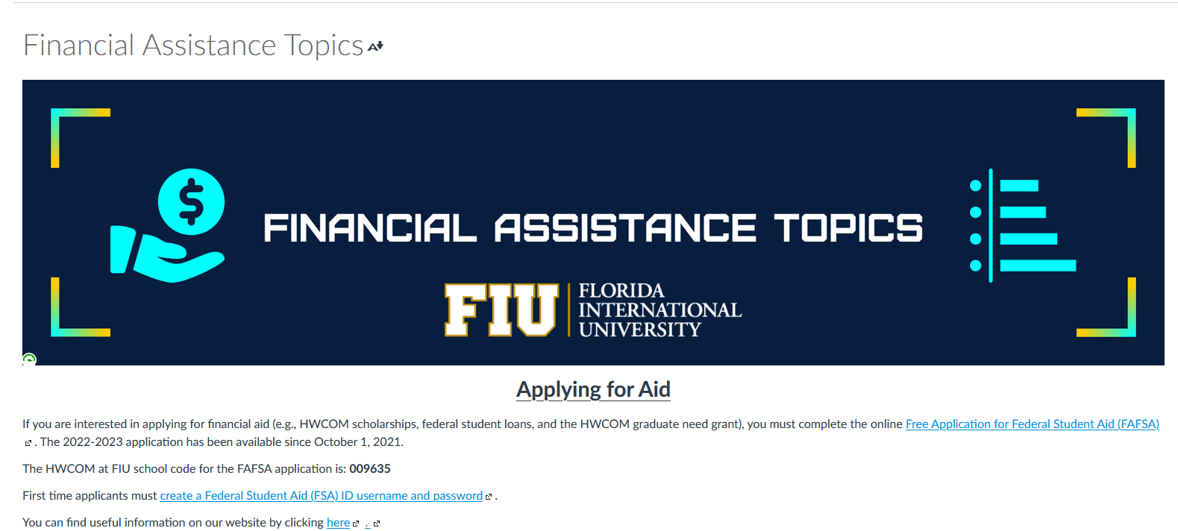
CanvasMed Links
Notes:
Under financial aid topics we accumulated a lot of useful information from our website that applies to all students, such as applying for financial aid, how to accept aid once it is offered, different types of aid available, and many similar topics

Slide 19
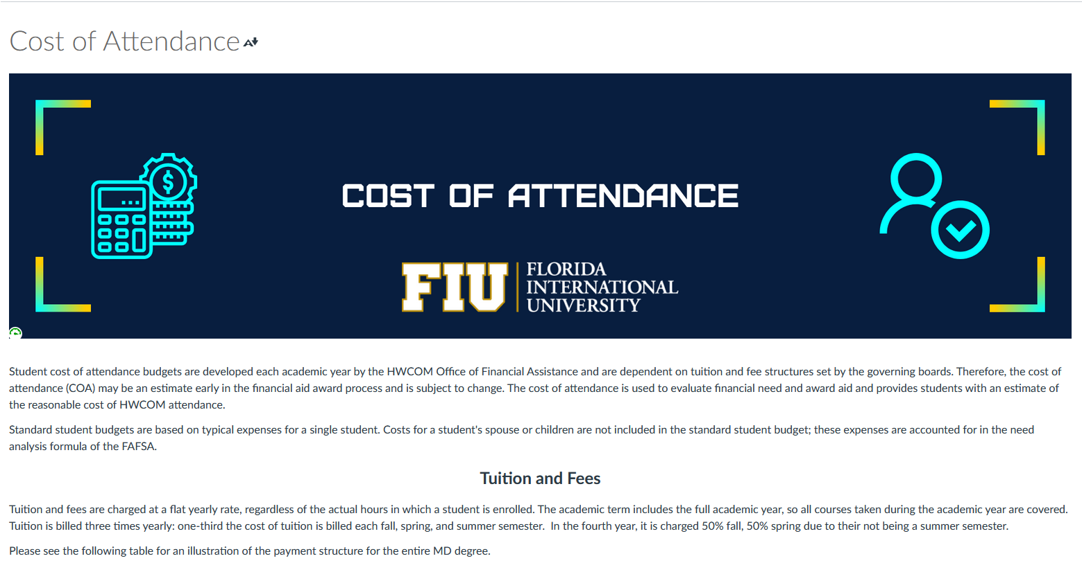
CanvasMed Links
Notes:
Under this section, we explain each category under the student’s cost of attendance and provide a link for the module where all the cost of attendance charts are available. This allows for students to access their current and potential future budgets so they always have an idea of what their financial aid will look like during their time in the college of medicine. These has proven very helpful to those students that like to budget, since it gives them an idea of future charges and of how much aid they will qualify to receive in future years.

Slide 20
CanvasMed Links
Notes:
We also created a section with a calendar for all the important financial aid dates (disbursement, payment due date, moneytalks events, etc). It helps that we can access it and change dates around and add any important event we may have at our office so more students are aware. Sort of an additional form of advertising for some of these events.

Slide 21
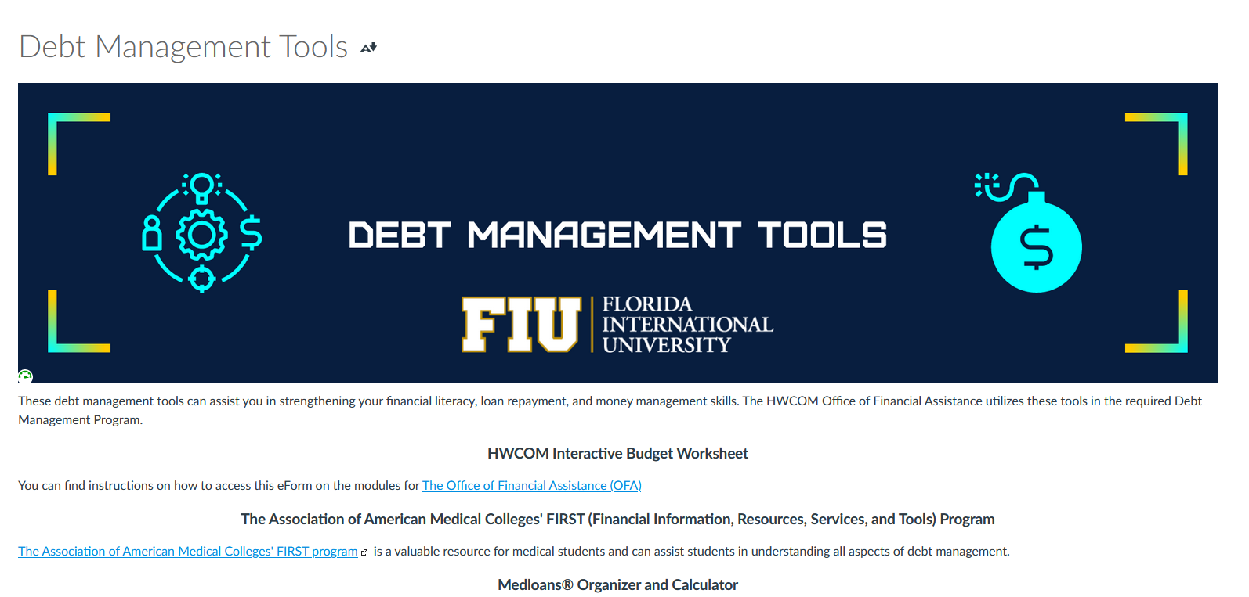
CanvasMed Links
Notes:
We created the Debt Management Tools section to include information on our existing Debt Management Program. We included the instructions for our electronic budget form (Which students can access directly through their student portals at FIU). We advertise the AAMC FIRST resources, including the MedLoan calculator, which is a staple of our entrance and exit counseling meetings with the students. We also include information on credit reports, and NSLDS. It’s important to have this in an area where a student can easily navigate and find it. We also make sure to advertise this canvasmed course constantly in meetings and presentations with our students, so they know they always have access to these resources

Slide 22
CanvasMed Links
Notes:
Probably one of our best and most visited sections, the Current Scholarships page. It allows students to see all currently available scholarships (both external and internal) together in one section so they can visit this page at any time during the year and find out what opportunities may be available to them at that moment. It does require maintenance from our office, to update the opportunities displayed. However, I believe it’s worth it due to the access it provides to our students on funding opportunities available at each time during the year. We also share them as they become available through our InnerCOM, which is our weekly student and staff newsletter. this helps reduce the number of emails the students receive, which is a complaint we’ve had from our students about missing our emails due to the large amount of daily emails they received from FIU. Now, they get considerably less emails and are more likely to read communications. We love having this sections since it helps to have all opportunities in a constant area where students can review and become interested even if they missed the email advertising it.

Slide 23
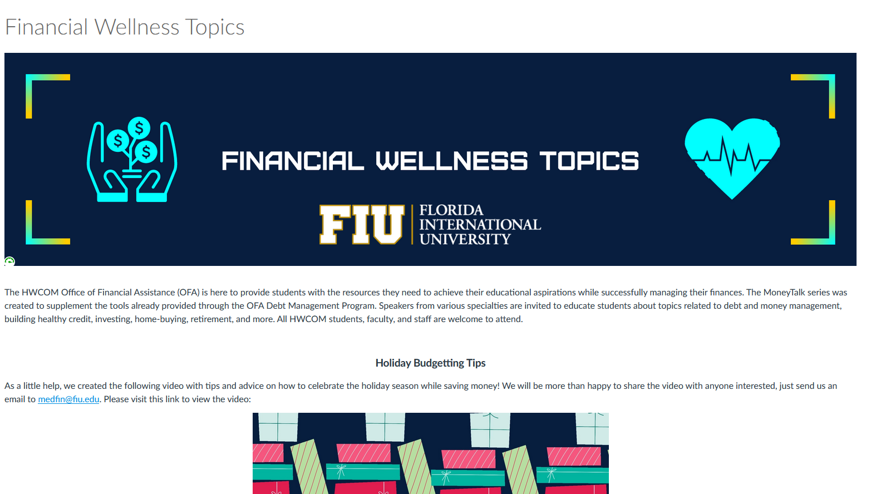
CanvasMed Links
Notes:
In this section, we share the different available financial wellness resources, webinars, MoneyTalks video recordings, and related news articles to keep students informed at all times as well as educated on financial topics.
Does anyone have any questions about the CanvasMed before moving on?

Slide 24
Poll #3
Does your school have an existing advisory board to work with your team?
https://PollEv.com/vanneweiss541
Notes:
Before moving on to our next topic, we’ll have our last poll. Does your school have an existing advisory board to work with your team? – another simple yes or no format. I will give a minute for everyone to respond -------- Wonderful results from the Poll, we can see from the polls that there are/not many schools that have this option for their students.

Slide 25
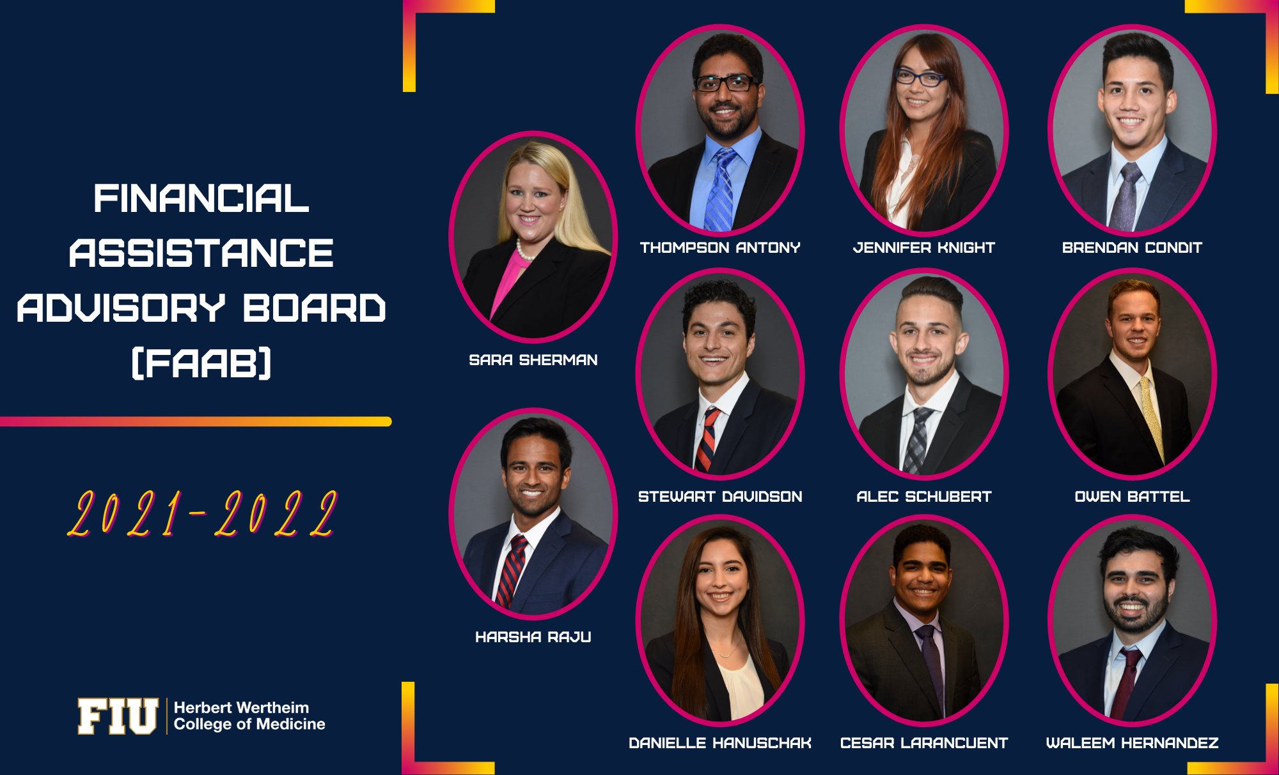
Financial Assistance Advisory Board (FAAB)
Created for our Team on the streets
We wanted to get direct student opinion on our existing practices
Be more aware of student busy peak times to schedule around it and increase participation
They help during our events and help to advertise deadlines and presentations
Notes:
In our office we kept having presentations and events and the students were not as engaged, seemed a bit confused sometimes or would ask questions later on things we had explained. This was a sign we had lost their attention at some point. So we created this advisory group, the FAAB, in order to have the student’s opinion more easily available and accessible. We have more members than those pictured in the slide, since many are non voting, The ones above where the voting members for this academic year. We developed this FAAB group in order to have more accessibility to our student’s needs and complicated daily schedules. By having a group of students from each cohort who are willing to meet with us, we can always ask about where each cohort is at in that moment and better schedule our programming.
We also wanted to have eyes/ears in the street team type of concept. Where we would discuss with our FAAB first about upcoming activities and events, and they can help with telling other students about it as well as gauge student interest. Many times students will ignore the excessive emails they receive, so having a classmate from the same group chats and that sees them every day give this information out ensures another medium of communication and of reaching a greater number of students. Most importantly, we want to make sure all of our programs are tailored specifically to our student population. So we are very happy to be able to ask them directly what they would like to see.

Slide 26
Analysis of FAAB
Advantages include:
- Direct student line to give updates about upcoming deadlines, and work directly with students on programming
- If you can find the right students, they will handle the board themselves and you can be a supervisor or just watchful participant.
Disadvantages include:
- Not all students will have the extra time to participate and dedicate themselves to the FAAB
- The students may feel more comfortable to ask you to extend deadlines and open additional opportunities that are not available, and they may get discouraged.
Notes:
I will say, there are of course some limits on what you can do with the board and a few challenges. But overall, they’re a great informative resource! Even just having a board for a year may help with your programming and improvements overall.
Example: Juan with the White Coat Investor books
Any questions on our FAAB before moving on?

Slide 27
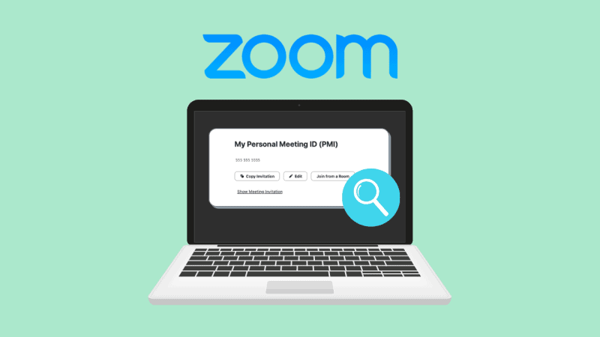
Zoom
Facilitates the access to the programming to both students and staff/faculty
Allows for ease of location
Allows for easy reporting and recording of each programming event
Allows for scheduling outside business hours
Notes:
Lastly, one very good piece of advice would be to host as much as possible Zoom events (you can also use Skype, Teams, etc). If your students are still working remotely and are suffering from Zoom fatigue, this may not be very effective, but otherwise, it really does expand the possibilities for events. We were able to retain more presenters (who volunteer their time for free to educate our students) since we made our MoneyTALKS predominantly remotely through Zoom. That saves them the trip to our campus, and they can do it from the comfort of their office and then get right back to work. It also allows us to record sessions so whenever a student misses one, they can make up the presentation by watching it later at their leisure (which is why we make them all available year round through their CanvasMed course page).
Any questions on Zoom before moving on?

Slide 28
Takeaways
Be open to student feedback
Interest Groups Collaboration
Online programming format
After hours programming
Incentives!
Build a FAAB to assist
Notes:
Read takeaways And the biggest takeaway I hope everyone got from this presentation is to work directly with the students.

Slide 29
Business Partners

Slide 30
Questions?

