Slide 1
Financial Learning at Valencia
Ilia Cordero
Assistant Director, Financial Aid
Osceola, Lake Nona, and Poinciana Campuses
Co-Presenters: Kathy Suarez & Odette De Leon

Slide 2
Today
History
Important successes
What we do
Meet the team
Loan default prevention

Slide 3
History
Notes:
History 10-12 minutes
Cohort Default Rate, FLIRT
Funding
Campus expansion
Life after funding
Publications – PBS News Hour article, The Fed report.
History in pictures (Noraida?)

Slide 4
The Beginning – FLIRT (2009 – 2010)
2009 - Financial Literacy Initiative and Research Team (FLIRT)
Growing Cohort Default Rate (CDR)
Committee Composition
Student Services, Student Development, Faculty and others
Pilot of student Ambassadors already in place
What we learned
Buy-in
Branding
Notes:
Internal team assembled to discuss CDR
Who was on the committee?
What was learned?

Slide 5
Results of FLIRT
Financial Literacy Program
Peer-to-peer learning
Loan Default Prevention Program
Staff-led initiative
USA Funds - $75,000 for three-years
Notes:
As a result of the work of the FLIRT committee, two important initiatives were created: A peer-to-peer financial literacy program and a loan default prevention program
* Add pictures here

Slide 6
First-steps in P2P Approach (2009 – 2010)
2009 – Osceola Campus Work Study/ Ambassadors
No funding
Why peer–to-peer? Because it works!
Win-Win-Win (Nifakis, 2007)
Student learners
Ambassadors
The College
Notes:
2008 I began as Coordinator of Financial Aid at the Osceola Campus, I noticed on campus when financial aid was disbursed there was a buzz in the air! Excitement building and then we had several work study students in the office discussing how they were going to spend their. Buying the latest cell phone, I would see more students on campus with Starbucks coffee cups in their hands and I would notice that when Summer registration came around that students has empty pockets and came into the office asking for scholarship information funds to cover the summer term.
So I decided we needed student behavior to change…. I decided to put three student work study students together and asked them what their money management skills were like? I asked them what did they do with their financial aid refund check? It was interesting and fascinating at the same time! These students began having a conversation about their money habits and gave each other ideas on how to better manage their money.
This is when I decided to create the Financial Learning Ambassador Program. I changed what I called them from Work Study to Ambassadors, by simple changing their name empowered them to behave different. They felt their mission was different. So we went and created home made tee shirts and began to make to integrate with Student Development Activities, clubs and organization.

Slide 7
USA Funds (2010 – 2011)
$75,000 grant - $25,000 per year for three years
Expansion to college-wide program
Provides guidance on the Financial Learning Ambassador/ Advisor Guide
Notes:
The Financial Literacy initiative and research team went traveling to various campuses and showcased the Financial Learning Ambassador Program
USA Funds showed interest and in our program and did a site visit and offered to provide us a 3 year $25,000 USA Grant to implement the program on all of our campuses.

Slide 8
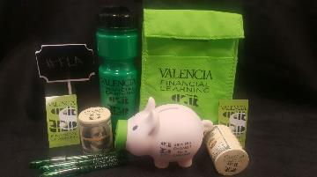
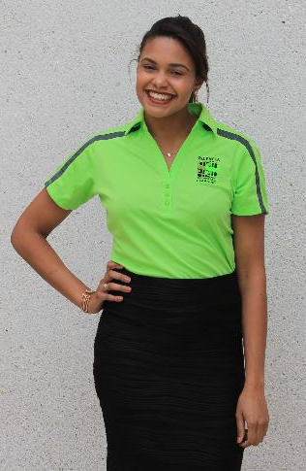
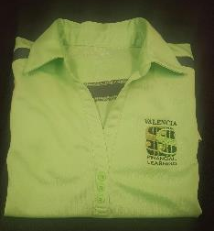
The Brand (2010-2011)
Notes:
Add pictures of the logo here

Slide 9
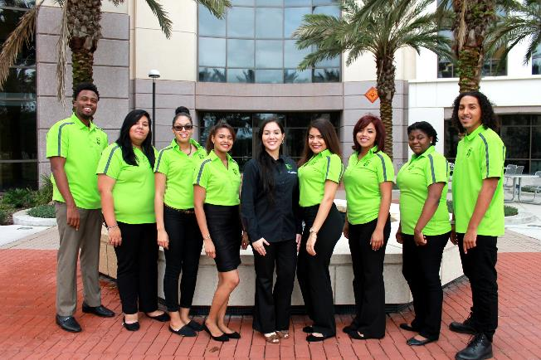
Financial Learning Program Brand

Slide 10
Wheels in Motion (Spring 2011)
Funds are used to purchase promotional items:
Uniforms
Tablecloths
Marketing flags
Promotional items
The infamous “Money Tree” is born
Mission and Vision

Slide 11
Mission and Vision
The mission of the Financial Learning Ambassador Program is to promote financial literacy among the student body through peer-to-peer learning.
The program will empower Valencia students to improve their personal financial awareness, fostering a lifelong road to financial success.

Slide 12
College-wide Expansion - 2011
Advisors to the program are designated on each campus
Materials and supplies are distributed to the campuses
Ambassadors are hired, and the program begins to take shape
Audience question
Notes:
Audience question – 5 minutes
By a show of hands, how many of you have financial learning/ financial literacy program at your institutions?
How has it been received so far?

Slide 13
Elements of Success
Notes:
Successes – 10 minutes
Branding – logo, shirts
Partnerships – USA Funds, Todd Romer, Jackie Cummings-Koski (bring her book), Student Development, Faculty, Campus events
Not reinventing the wheel – getting help from student development
Publications – attention from outside parties
Short description and scope of NSE “Highest enrolled course at the college. Part of GenEd for the AA and some AS degrees.“
Big one – NSE partnership with GradReady and Heather Ramsier – picture of GradReady
Great Lakes Financial

Slide 14
Financial Learning Ambassador Logo
Notes:
Successes – 10 minutes
Branding – logo, shirts
Partnerships – USA Funds, Todd Romer, Jackie Cummings-Koski (bring her book), Student Development, Faculty, Campus events
Not reinventing the wheel – getting help from student development
Publications – attention from outside parties
Short description and scope of NSE “Highest enrolled course at the college. Part of GenEd for the AA and some AS degrees.“
Big one – NSE partnership with GradReady and Heather Ramsier – picture of GradReady
Great Lakes Financial

Slide 15
Partnerships
USA Funds
Todd Romer
Jackie Cummings Koski

Slide 16
Partnerships
Student Development – No need to reinvent the wheel
SLS 1122 – New Student Experience
One of the highest enrolled courses
required for all AA and some AS Degrees

Slide 17
Key Partnerships-Grad Ready
Notes:
Shouldn’t the key partnership be with Great Lakes Financial? GradReady is the method of partnership.

Slide 18
GradReady
Notes:
Moved up.

Slide 19
Key Partnership-Student Success Faculty
Heather Ramsier- Faculty created assignments that aligned with Grad Ready

Slide 20
Spreading the Word
Federal Reserve Bank of Boston
PBS News hour
U.S. Financial Literacy and Education Commission, 2015
Ilia M Cordero- Assistant Director Financial Aid Services, Founder of the Financial Learning Ambassador Program

Slide 21
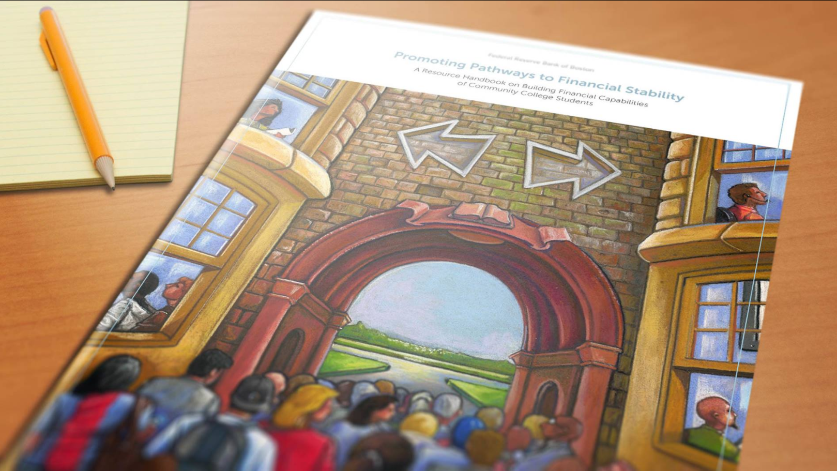
Federal Reserve Bank of Boston
The program is featured in a publication by the Regional and Community Outreach department
Promoting Pathways to Financial Stability: A Resource Handbook on Building Financial Capabilities of Community College Students

Slide 22
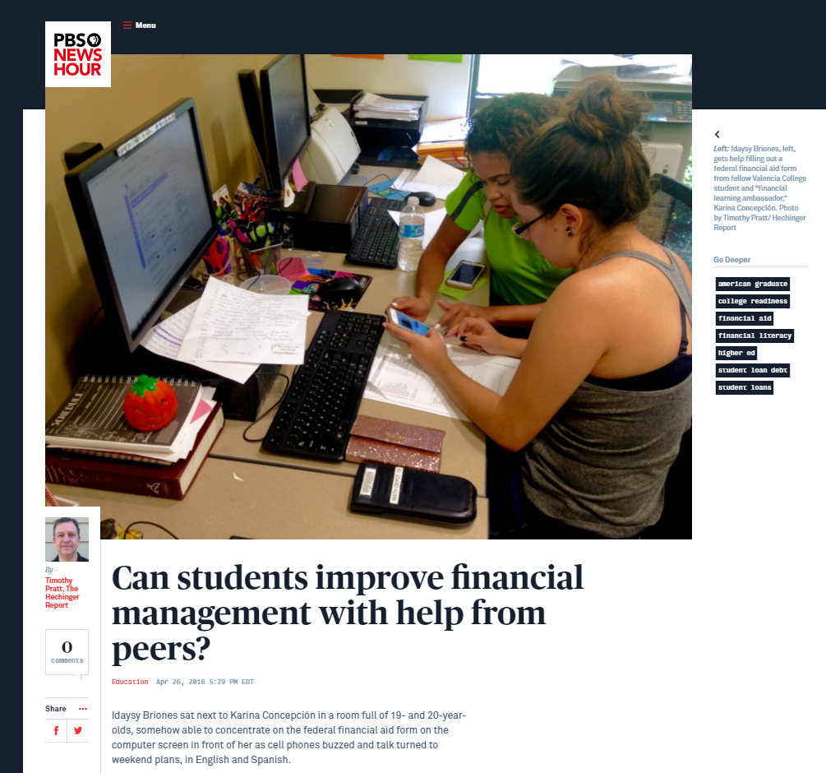
PBS News Hour

Slide 23
U.S. Financial Literacy and Education Commission

Slide 24
How it Works
Notes:
How the program works – 10 minutes
Noraida will discuss:
Recruitment
Training Canvas
Mentorship
Describe all or most events and tablings (have ambassadors help with this part)

Slide 25
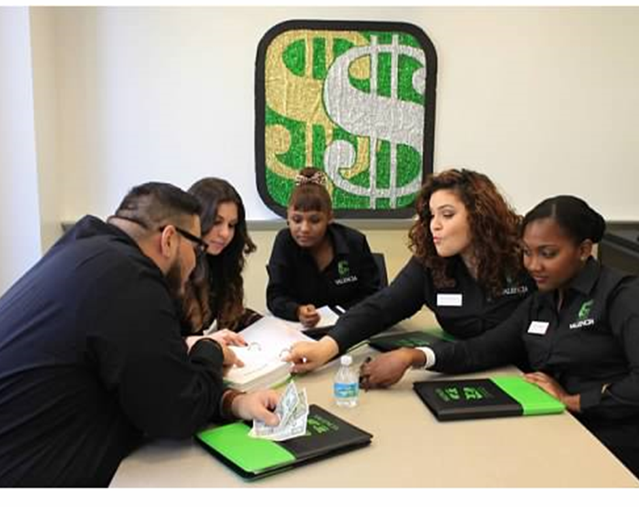
Where do we implement Financial Literacy Education
Recruitment
Mentorship
Training
Classrooms
Skill Shops
Tabling
Campus Events
Community events
Tools

Slide 26
Recruitment
We take in students that may not get the chance somewhere else and give them the opportunity to blossom

Slide 27
Mentorship
We mentor the Ambassadors to make wise financial decisions
We empower the FLA with life skills to become better students and successful adults during and after college
Notes:
for example: with their FAFSA Refunds, choosing scholarship over loans and to Budget

Slide 28
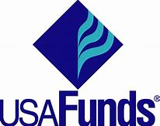
Training
Training Used throughout the years:
USA Funds- Life Skills
Great Lakes: Grad Ready
FLA Canvas Online Course
FERPA
Notes:
Discuss we began using USA FUND life skills and then the online modules became obsolete.

Slide 29
Canvas Online Training Program

Slide 30
Classroom Presentations
SLS 1122 Student experience classes
Psychology
Accounting
Business classes
Usually 1 hour presentation
Presentations on saving, budgeting and cost of college
FLA visits 15-25 classrooms a semester per campus

Slide 31
Skillshops
Free workshops on campus that assist students with their academic, personal and career development

Slide 32
Skill Shops
Holiday themed events
Affordable Gift ideas
Extra Credit for students attending
Free food

Slide 33
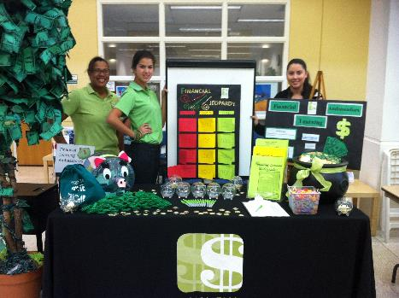
Tabling
Located in a high traffic student areas, near the cafeteria
Create unique marketing flyers to give to students

Slide 34
Tabling
Play quick games on the wheel of opportunity
Purposeful Giveaways like lunch boxes, piggy banks and water bottles

Slide 35
Campus Events
Partnering with Student Development, not recreating the wheel
Access to many students at one time
Project Runway to Saving

Slide 36
Community Events/Partnerships
Got College initiative Working with local community colleges
Junior Achievement high school students- Cost of Post secondary education

Slide 37
Community Events-Partnerships
Toyota- New and used car on campus
Partner with local libraries to have FAFSA FRENZY events. Assisting students to completing the FAFSA
Partner with schools and the YMCA

Slide 38
Tools Created
Financial Learning Ambassador (FLA) Advisor Guide
Financial Learning Ambassador (FLA) Guide
FLA Service of Excellence- Program requirements
FLA Job description

Slide 39
Being an Ambassador
Notes:
Ambassadors share their experience – 5 minutes

Slide 40
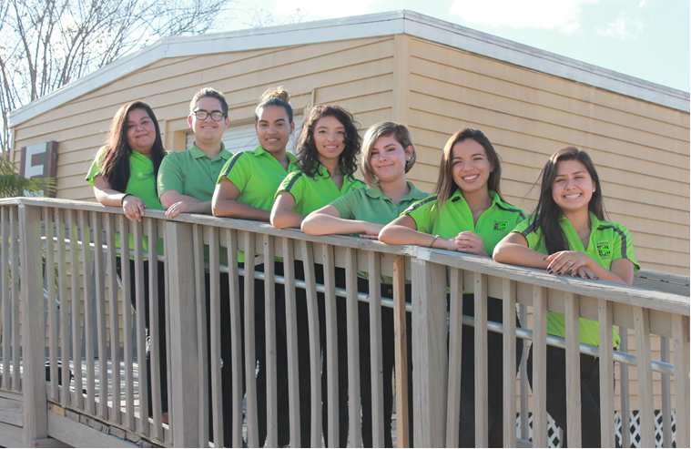

Slide 44
Any Questions? Thank You
Contact Information:
Phone: 407-682-4871
Email: icordero2@valenciacollege.edu

Slide 45
Valencia College Default Prevention Initiatives
Sedrick Brinson
Financial Aid Specialist
Default Prevention Advisory Committee Chair

Slide 46
The Beginning
As a commuter school with no on-campus housing, 60 percent of students at Valencia attend part time, and many work and forego student loans. However, from 2008 to 2012, Valencia experienced a 40 percent enrollment boom that increased the overall number of student borrowers. The reason for this increase was because Valencia College Board of Trustees voted to keep tuition at a flat rate of $99.06 per credit hour. Despite Valencia College not being at sanction level, recent CDR fluctuations have garnered the attention of staff and administrators.

Slide 47
A Brief Overview of Valencia’s Default Prevention Plan

Slide 48
Communication Across Campus
On October 2, 2014, we implemented our Default Management Committee to get the commitment from key individuals’ college wide to acknowledge and support default management and prevention. Since then, the name of the committee was changed to Default Prevention Advisory Committee. The reason for the name change, was to “prevent” the student from going into debt, not “manage” their debt.

Slide 49
Default Prevention Advisory Committee
Valencia College selected a group of key players who are integral to the student learning experience from beginning to end and who have the background and knowledge to target specific student populations.
Financial Aid Specialist – Chair Dean of Students
AVP of Financial Aid Svcs. Director of Student Services
Director of Financial Aid Svcs. Director of Enrollment Services
Asst. Director of Financial Aid College Counselor
Institutional Research Analyst Director of Admissions
Campus Dean Manager of Learning Support

Slide 50
Goals of the Default Prevention Plan at Valencia
To keep Valencia’s default rate in the mid-range of the scope of similar two-year institutions and to strive for keeping the 3-year rates below 15%.
Provide interventions that target borrowers and provide financial literacy.
Conduct outreach to borrowers during repayment to assist in navigating the repayment process via USA Funds Borrower Connect software.
Analyze the current cohorts to determine students that are most likely to default and target outreach to those groups.
Provide training to all Financial Aid staff to assist borrowers with repayment strategies.

Slide 51
Valencia Student Loan Borrower Population
As you can see the loan volume, number of borrowers and average loan debt is reducing. Policy changes have effected these numbers (i.e., algorithmic budgeting, SAP). Two major changes were our awarding process and SAP policy. In the 2013-2014 aid year we initiated Algorithmic Budgeting. The benefits to Algorithmic Budgeting are that a student’s budget is adjusted to reflect the actual enrollment status and adjustments are made to budget components, which in turn lessen the amount a student can borrow for a single term.

Slide 52
Valencia Historical Default Rates

Slide 53
The Early Stages of Enrollment
New Student Experience (NSE Course)
Incoming first-year students will be given an overview of the financial aid process, student loan responsibilities, and basic money management skills, through New Student Experience (NSE)/ Student Life Skills (SLS 1122) courses.
Open House and Got College (College-Wide & Osceola Campus)
As prospective students interact with Valencia College the current practice is to provide information on the cost of attendance and the process of how to apply for financial aid. Students have the opportunity to speak with a financial aid specialist for assistance with the student aid process.
Transfer Orientation (College-Wide)
A Financial Aid Specialist prepares materials regarding the different types of student loan repayment plans, Managing Your Credit booklet, etc. Transfer students also receive a personalized letter stating how much they have borrowed since the beginning of their educational career.

Slide 54
Student Loan STD’S

Slide 55
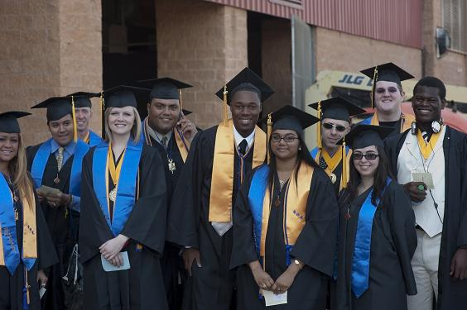
Valencia’s Accomplishments & Initiatives

Slide 56
Grad Finale
Valencia College provides activities for the graduates by requiring graduating students to meet with a designated financial aid specialist regarding any student loans that they received while at Valencia College.

Slide 57
Nursing Orientation
At the Nursing Orientation, students are given personalized letters informing them of how much loan debt they incurred while enrolled in Valencia Nursing Program.

Slide 58
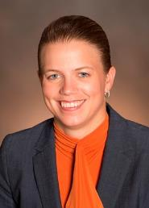
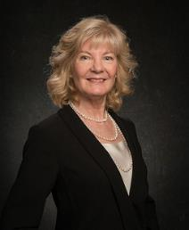
Campus President’s Leadership Meeting
Presentations were done at each of Valencia Campus President’s Leadership Team meetings to educate and express the importance of Valencia’s default prevention initiatives. The presentation explained the long-term goals regarding loan borrowing, financial literacy, repayment plans & incentives, as well as steps to avoid student loan default.
Dr. Falecia Williams
West & Downtown
Campus President
Dr. Kathleen Plinske
Executive Vice President & Provost/
Osceola & Lake Nona Campus President
Dr. Stacey Johnson
East & Winter Park Campus President

Slide 59
Valencia FY2016 3-YR CDR Statistics

Slide 60
Loan Record Detail Report (LRDR)
A loan record detail report contains information on the loans that were used to calculate a school’s draft or official cohort default rate. The loan record detail report lists a school’s Federal Family Education Loan (FFEL) and/or William D. Ford Federal Direct Loan (Direct Loan) activity, including but not limited to
The number of borrowers who entered repayment during a given fiscal year, and
The loan status of those borrowers

Slide 61
Student Loan Default - Ethnicity & Gender

Slide 62
Student Loan Default - Transferred & Taken Dev Ed Courses

Slide 63
Student Loan Default – Overall Credit Hours Earned

Slide 64
Student Loan Default by Program
Our Institutional Research Office researched the programs we offer to see how many students were defaulting in their perspective programs and these are the top four (4) programs:
AA - General (37 students – 8.3%)
AS – Nursing (4 Students – 0.90%)
AS – Criminal Justice (3 Students – 0.67 %)
AS – Business Admin. (3 Students – 0.67%)

Slide 65
Student Loan Default - SAP

Slide 66
Student Loan Default – Pell Status and First Generation

Slide 67
Student Loan Default – Graduated

Slide 68
Student Loan Default – Age

Slide 69
Any Questions? Thank You
Contact Information:
Phone: 407-582-5236
Email: SBrinson5@valenciacollege.edu

