Slide 1


R2T4 Ahoy! Navigating the Waters of Student Aid Returns
Alison Cagle, University of South Florida

Slide 2
Disclaimer
Members of the Association recognize that one of the purposes of the Association is to provide training and informational services to its members through training conferences and periodic written material. While the Association shall utilize its best efforts to provide its members with the most current information available, there can be no assurances or warranty that its interpretation of any rule, regulation or statute will be in conformance with any present or future interpretation of such rule, regulation or statute by any appropriate governmental authority. Accordingly, each member shall hold the Association harmless from any claims, damages, or liability resulting from such member’s use of any information, data, or interpretations as provided to such members by the Association.

Slide 3

Agenda
Key Concepts
R2T4 Formula & Timeframes
R2T4 Calculation Walkthrough
Student Advising Tips
Q&A

Slide 4

Key concepts
R2T4: The muster drill of financial aid!

Slide 5
what is return of title iv (R2T4)?
The calculation required when a recipient of Title IV aid withdraws from an institution during a period of enrollment in which the recipient began attendance.
A withdrawal means the student ceased attendance in all courses during the payment period/period of enrollment
Modules have different rules for what defines a withdrawal
Clock hours: student does not complete all scheduled clock hours and weeks of instructional time in the payment period or period of enrollment
Payment period = standard term as defined by institution
Period of enrollment = nonstandard terms
Earliest date through latest date of all courses a student is continuously enrolled for a complete term
The calculation compares the amount of Title IV aid the recipient earned to the amount disbursed and determines whether funds must be returned.
Payment Period
Period of Enrollment

Slide 6
What aid is returned?
Title IV Aid is:
Pell Grant
Federal Supplemental Educational Opportunity Grant (SEOG)
Direct Loans (subsidized/unsubsidized)
TEACH Grant
Grad PLUS/Parent PLUS Loans
Title IV Aid is NOT:
Scholarships/Bright Futures
State Grants (FSAG, EASE)
Institutional Aid
Tuition Waivers
Private Loans
NOTE: these may still require separate adjustment if enrollment is altered

Slide 7
what’s the difference?
Official Withdrawals:
Student properly notified institution of intent to withdraw
Year-round process: financial aid office notified throughout the term
Terminology: withdrawal date
Unofficial Withdrawals:
Student stopped attending classes or failed to complete a period of enrollment without notification
Usually done at end of term after grades post
Terminology: last date of attendance
Schools have a choice to use midpoint of payment period/period of enrollment or last date of academic engagement
Schools required to take attendance must use last date of academic engagement
Also includes students who failed the term (if not required to take attendance)
No grades of D or above
Applies to students with missing or incomplete grades

Slide 8
Academic engagement
Includes:
Attending a synchronous class, lecture, field activity, or laboratory activity, either physically or online, where there is an opportunity for direct interaction between the instructor and students
Submitting an assignment
Taking an exam or assessment
Participating in interactive computer-assisted instruction (i.e.: tutorial, webinar, online discussion)
Participating in a school-assigned study group or group project
Interacting with a faculty member regarding the academic subject studied in the course
Does NOT include:
Living in campus housing
Using meal plan
Logging onto an online class/tutorial without active participation
Attending an advising/academic counseling session

Slide 9
Aid reinstatement
If student rescinds withdrawal notification, notice must be in writing and indicate student will finish payment period/period of enrollment (if institution is not required to take attendance)
If student subsequently withdraws, use whichever date is later:
first notification of intent to withdraw
the date the official process began
the last date of academic engagement
Notes:
If both dates are triggered, earliest date is used (for example, student calls an office notifying of intent to withdraw on November 1 but fills out withdrawal form on December 1, November 1 would be used) UNLESS student academically engaged

Slide 10

R2t4 formula & timeframes
Man the lifeboats: don’t go overboard!

Slide 11
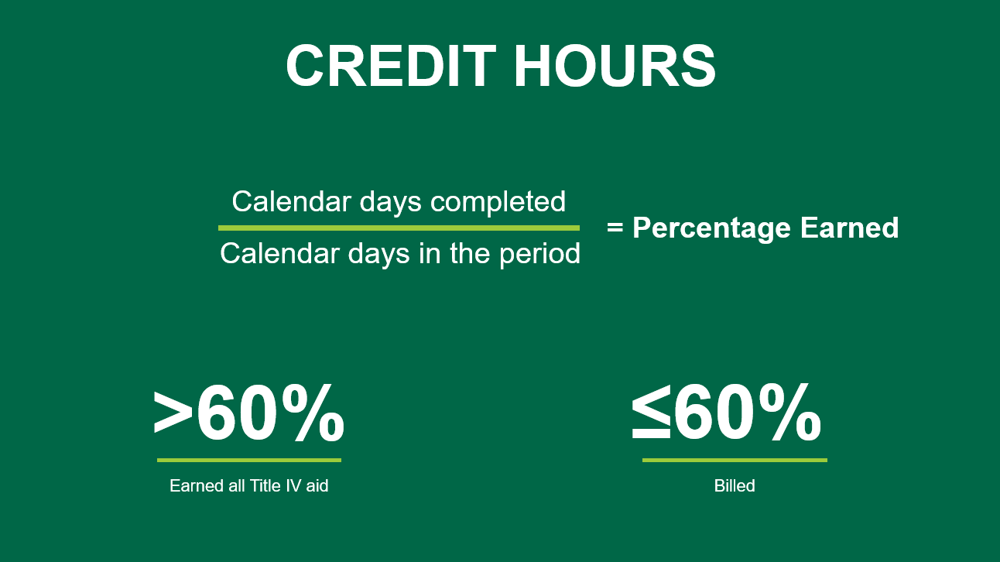

Slide 12
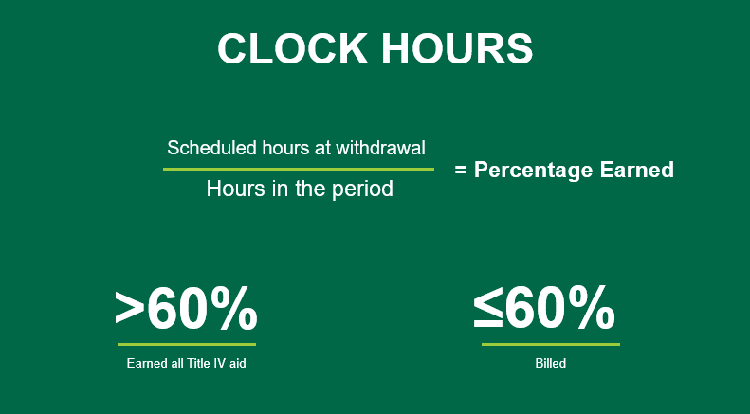

Slide 13
Things to consider: r2t4 formula
For modular programs, only include completed days in numerator
R2T4 is required if student is not scheduled to begin another course within 45 days after the withdrawn module ends (unless the student is on an approved Title IV leave of absence)
Financial Aid office needs to get confirmation of student’s intent to attend future courses
An R2T4 calculation is not required if a student successfully completed a module or combination of modules that include at least 49 percent of the countable days in the payment period/period of enrollment.
An approved leave of absence (LOA) should be excluded from denominator along with 5+ scheduled breaks (i.e.: spring break, hurricane closure)
Number of days in denominator is determined based on whether an institution uses an R2T4 freeze date
For clock hour programs: modified scheduled hours are used only if modified before withdrawal
Any modifications must be in accordance with accrediting/licensing agency requirements

Slide 14

Leave of absence
A temporary interruption of student’s studies
Does not include:
Nonattendance during a scheduled break
Situations addressed by incomplete courses
Formal policy for R2T4 purposes not required
If formal policy exists and applies to Title IV funds, it must meet regulatory requirements to be approved for Title IV purposes

Slide 15
When r2t4 requirements do not apply*
situation | Perform r2t4 calculation | School returns funds | Student returns funds
Optional Withdrawal Exemption Policy | No | Yes | Yes
Partial Withdrawal | No | No | No
Completes Graduation Requirements | No | No | No
Student did not establish TIV Eligibility | No | No | No
Deceased | Yes | Yes | No
*Modular programs have different stipulations

Slide 16

timeframes
Institution-responsible funds: 45 days
Post-withdrawal loan disbursement: 14 days
Unearned grant funds (student is responsible): 45 days (or establish repayment agreement with ED)
Borrower repays unearned loan funds under the terms of the master promissory note (MPN)
Aid reinstatement: 180 days
Note: An R2T4 calculation is still required even if the student has earned all aid to determine whether a post-withdrawal disbursement (PWD) is required

Slide 17

R2t4 calculation walkthrough
Are you ready kids? Aye-aye, captain!

Slide 18
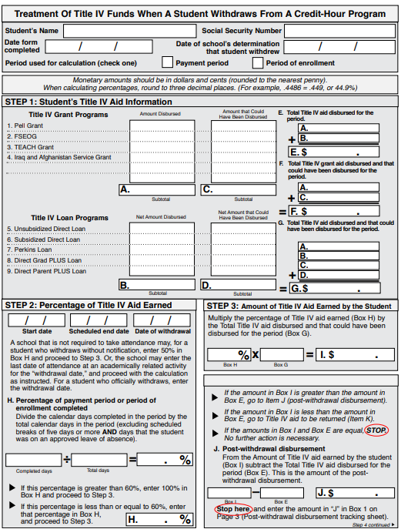
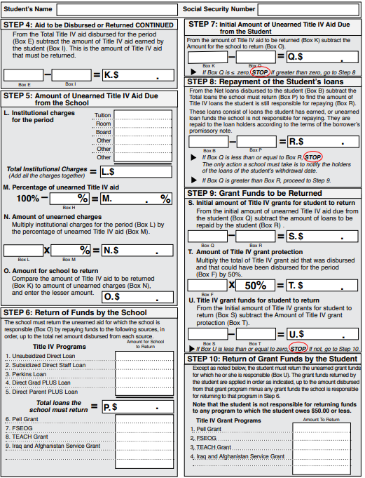

Slide 19
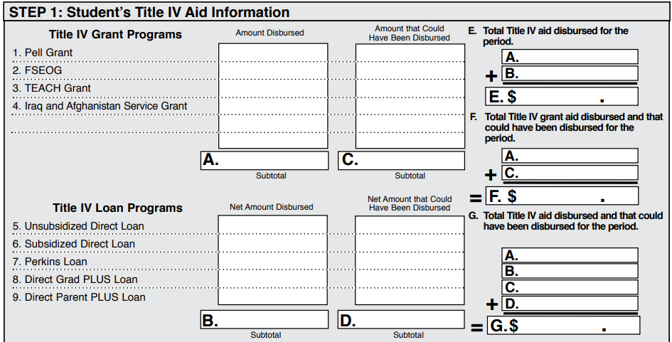
Step 1: student’s title iv aid information
Indicates the amounts of Title IV aid the student was eligible to receive for the period as of the student’s withdrawal date
Includes amounts that were disbursed as well as amounts that could have been disbursed

Slide 20
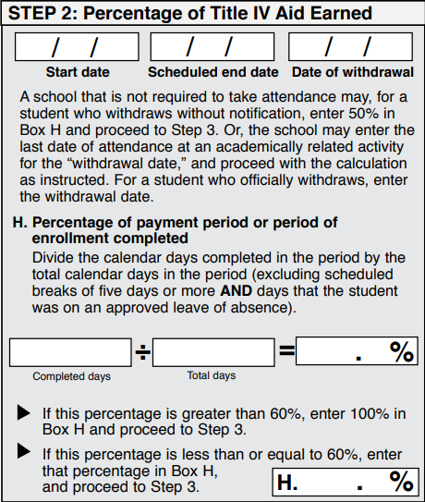
Step 2: percentage of title iv aid earned
Title IV aid is earned based on percentage of period completed
When calculating, round percentage to 2 decimal places (i.e.: 53.45%)
≤60%: portion of aid earned
>60%: all aid earned
Total days in period should be all calendar days and exclude scheduled breaks of 5+ days

Slide 21
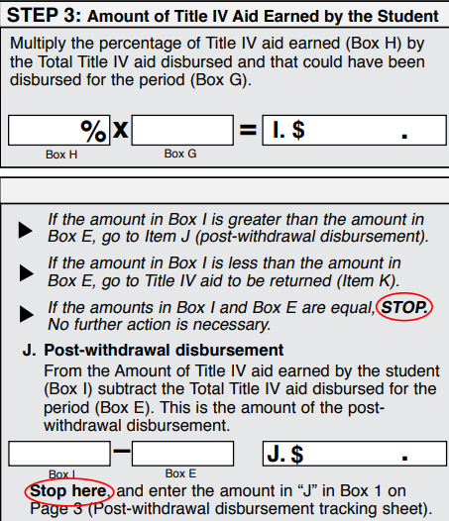
Step 3: amount of title iv aid earned by student
Title IV aid earned includes disbursed aid and aid that could have been disbursed
Even though it was not disbursed, student is eligible for aid that could have been disbursed at time R2T4 is calculated if:
Late disbursement occurred before school was aware of student’s withdrawal
Student has outstanding issues where the aid cannot be disbursed
Round to nearest penny

Slide 22

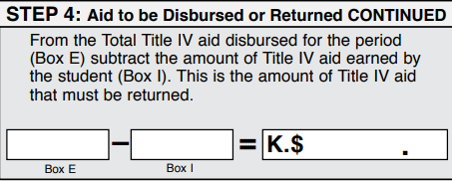
Step 4: aid to be disbursed or returned
Earned aid less than total disbursed aid: return will be made
Earned aid greater than total disbursed aid: post-withdrawal disbursement (PWD)

Slide 23
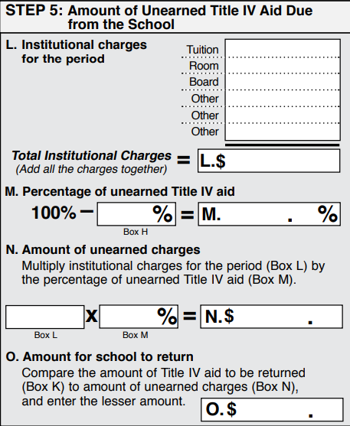
Step 5: amount of unearned title iv aid due from school
Lesser of total amount of unearned aid or amount equal to institutional charges multiplied by percentage unearned, whichever is less
Institutional charges used calculation are always those that were assessed the student for the entire payment period/period of enrollment prior to the student's withdrawal
Do not use reductions based on withdrawal made under school’s institutional refund policy
Notes:
i.e.: tuition forgiveness

Slide 24
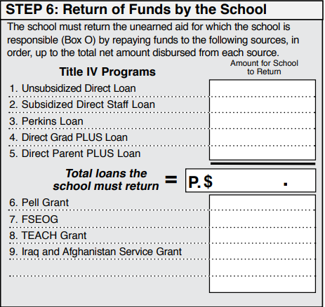
Step 6: return of funds by school
If student owes a portion of unearned Title IV funds, the school’s return(s) will be excluded
Round to nearest dollar

Slide 25
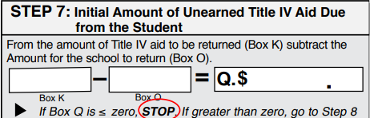
Step 7: initial amount of unearned title iv aid due from student
Difference between unearned aid and school’s required return portion

Slide 26
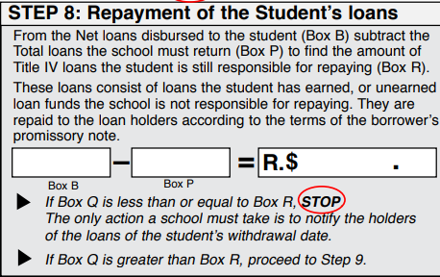
Step 8: return of student loans
Student repays unearned loan funds under the terms of the master promissory note (MPN) of the loan(s)

Slide 27
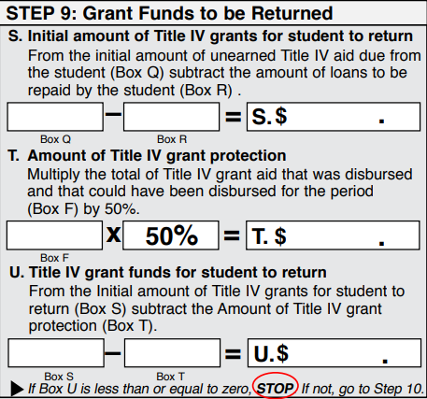
Step 9: grant funds to be returned
Title IV grant protection of 50% of total grant aid is applied before student’s responsibility is calculated

Slide 28
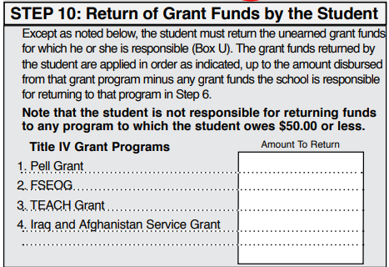
Step 10: return of grant funds by student
Grants are repaid in priority order: first Pell, then FSEOG, then TEACH
If return is ≤$50 per program, student is not responsible for repayment
Round to nearest dollar
Student has 45 days to return funds (or establish repayment agreement with ED) or will be flagged for grant overpayment

Slide 29

Advising students
They are our priority passengers!

Slide 30
When advising students remember:
Additional adjustments can occur automatically when hours change (waivers, Bright Futures, FSAG)
Student responsibility portion of grant repayment can be returned by the institution on the student’s behalf ($50 minimum provision does not apply)
Return amounts of <$1 do not need to be returned to ED
Pell can be reinstated for the next term in the same aid year (if eligible)
Students are responsible for any balance after R2T4 billing

Slide 31

Q&A

Slide 32

THANK YOU
Alison Cagle
alisoncagle@usf.edu

